Slide 1
Minimizing the Signal Interferences in Radar Systems through Digital Signal Processing
Muhammad Shahbaz Jaffar

Slide 2
Problem: Signal interferences threatens the safety of the radar System
RF interference for Autonomous vehicles
Increasing number of people living in cities there will also be more cars on the streets
Like car density and the absolute number of car's radar boost increases
Two radar sensors interacting also increases in some way
Signals from nearby radars and other transmitters can be strong enough to enter the radar receiver and cause false responses
Advanced radar detectors use jamming Signals
Testing and Verification in LAB environment

Slide 3
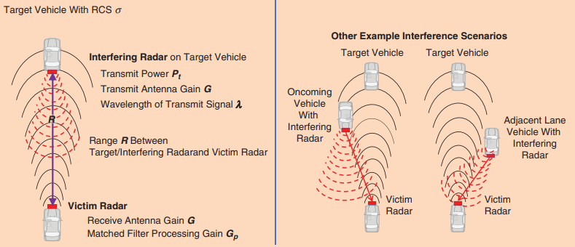
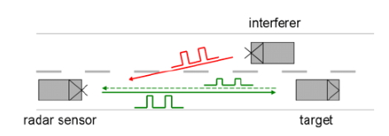
How and why do Interferences occur?
Fig 01 : Explaining the Interferences occurring [1]
Fig 02: Signal being contaminated [2]

Slide 4
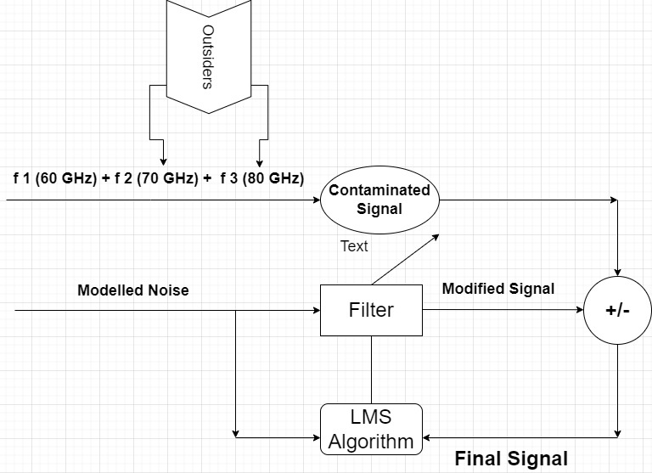
Implementation of Adaptive Filter
Fig 03: Basic Structure for filter Implementation

Slide 5
Steps to follow:
Formulated a LMS Algorithm in MATLAB
Performed Data Acquisition with RADAR GUI and Recorded it at desired frame rate
Exported data from saved Binary file to MATLAB with ‘Data Extracting from Binary file function.m’
Defined the function for inputs as arguments to the filter Algorithm
Selected the right parameters such as “filter coefficients” and “adaption rate”
Plotted all the signals for different time intervals involved to compare the results

Slide 6
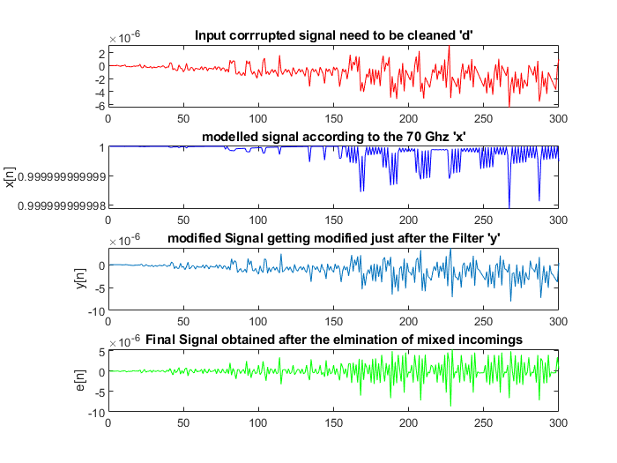
Signal filtering a Lower adaption rate:
Filter Coefficients = B = 30
Adaption Rate = 0.04
Fig 04: Picture comparing signals at different conditions

Slide 7
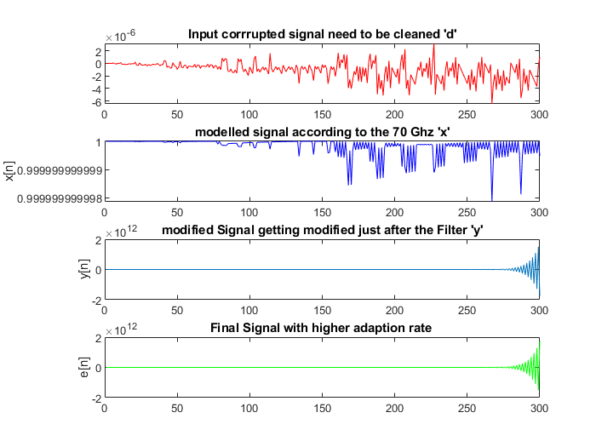
Signal filtering a Higher adaption rate:
Optimum Selection for Adaption Rate
Filter Coefficients = B = 30
Adaption Rate = 0.07
Fig 05: Picture comparing signals at different conditions at high adaption rate

Slide 8
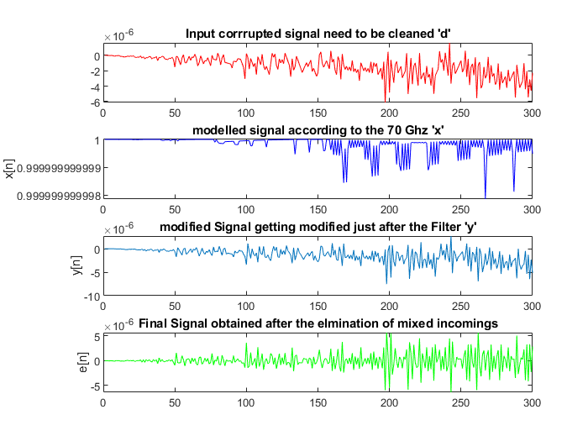
Real Time Applications:
Defined the range of real time radar usage frequencies 59 GHz to 63 GHz
Formulated range of variables frequencies at which original signal is getting mixed by the incoming signal
Fig 06: Real Time Application for filtering the signal

Slide 9
Conclusion:
Results are promising under the conditions
Selection of Right Parameters
Choosing the Optimum value subjected to the test hardware available
Lower Adaption Rate gives Higher Accuracy than Higher One

Slide 10
Improvements
Real time hardware application in LAB environment
Designing of PCB is a question for complex Digital Signal Processing
Converting the electrical signal into audio pulses of variable frequencies
Selecting the optimal solution for Electromechanical transducers

Slide 11
References:
[2]Yoshida, J., Samek, M., Dahad, N. and Dahad, N., 2022. Signal interference compromises automotive radar safety - Embedded.com. [online] Embedded.com. Available at: <https://www.embedded.com/signal-interference-compromises-automotive-radar-safety/> [Accessed 16 September 2022].
[1]Uhnder.com, 2022. [Online]. Available: https://www.uhnder.com/images/data/Uhnder_IEEE_Signal_Processing_Interference_Sept_2019.pdf. [Accessed: 16- Sep- 2022].

